Slide 1
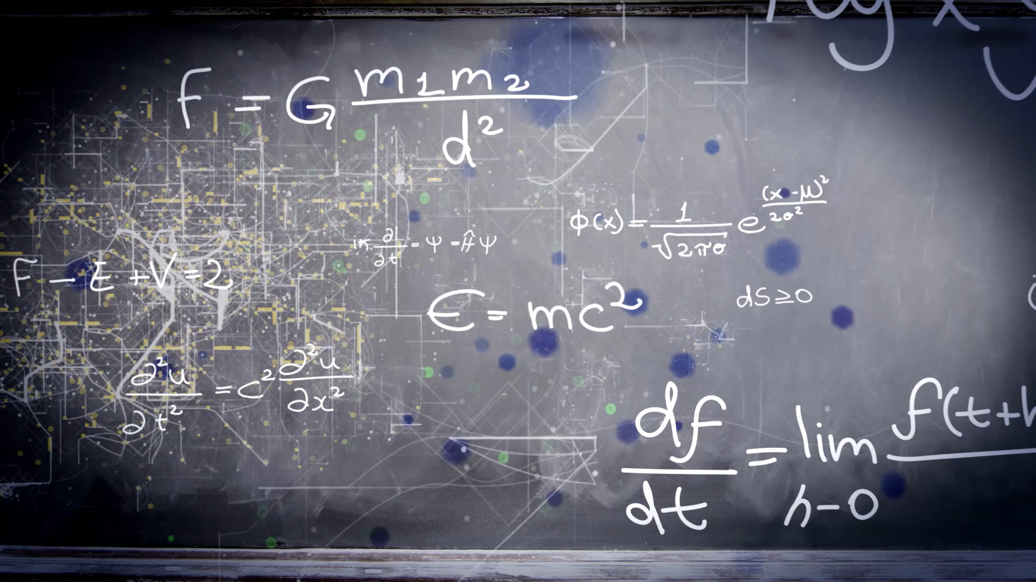
Main Function
Spring 2025
CSUN
Dr. Pouyan Eslami

Slide 2

What Is the Main Function?
Definition: The main function is a convention in Python used as the program’s entry point.
if __name__ == '__main__': statement.
Emphasize that it prevents code from running when the module is imported.
Example # 1

Slide 3
Purpose and Benefits
Control Execution: Centralizes where the program starts running.
Readability & Organization: Makes it easier for others to understand the flow of the program.
Reusability: Allows parts of your code to be imported without executing the main section.

Slide 4
Using Command-Line Arguments
The sys module in Python provides access to system-specific parameters and functions, allowing interaction with the Python interpreter and its environment. It's always available and doesn't require external installation.
Some common uses of the sys module include:
Command-line arguments: Accessing arguments passed to a Python script via sys.argv.
Standard input/output/error streams: Interacting with sys.stdin, sys.stdout, and sys.stderr.
Python interpreter information: Retrieving details like the Python version (sys.version), executable path (sys.executable), and module search path (sys.path).
Exiting the program: Terminating the script execution using sys.exit().
Exception handling: Accessing information about the most recent exception with sys.exc_info().
Platform specifics: Determining the operating system or platform using sys.platform.

Slide 5
Examples
Please refer to Examples 2 to 12

Slide 6
Lists
A list is an ordered, mutable collection used to store items.
Supports indexing, slicing, and dynamic resizing.
[1, 2, 3, 4, 5]

Slide 7
List Properties and Use Cases
Lists can be modified after they are created.
Elements maintain the order in which they were inserted.
Common Uses:
Data collection, iteration, and dynamic arrays.

Slide 8
Examples of Lists
my_list = [1, 2, 3, 4, 5]
print(my_list)
For more examples refer to VS Code. Example 1 to 15.

Slide 9
Tupples
Tuples are ordered, immutable sequences used to store collections of items.
Contrast tuples with lists: Tuples cannot be modified.
a simple tuple like (1, 2, 3)

Slide 10
When and Why to Use Tuples
Ideal for fixed data that should not change.
Tuples can be slightly faster and are hashable, making them suitable as dictionary keys.
Returning multiple values from functions, storing configuration values, and more.

Slide 11
Tupple Examples
Please check 13 Tupple examples.

Slide 12
Dictionaries
Dictionaries are mutable, unordered (in older versions; insertion ordered in Python 3.7+) collections of key-value pairs.
a simple dictionary-like {“name”: “Alice,” "age": 25}.

Slide 13
Use Cases and Benefits of Dictionaries
Access values quickly using keys.
Access values quickly using keys.
Define dictionaries using curly braces.
Check 17 Examples of Dictonaries

Slide 14
Strings
Strings are sequences of characters used to represent text.
Strings cannot be changed once created.
A simple string like "Hello, Python!".
Any modification creates a new string.

Slide 15
String Examples
Please check the VS Code.

